Slide 1
‘Why so many Italian and Spanish students come to Poland?’
Javier Montero Acosta

Slide 2
Who am I?
Something about me

Slide 3

@javimonteroblog
Blog: javimontero.blog

Slide 4
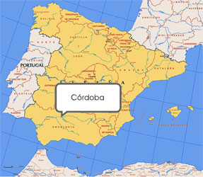
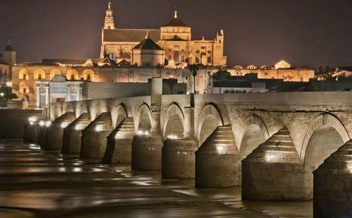
I am from…
Córdoba
Mezquita Catedral

Slide 5
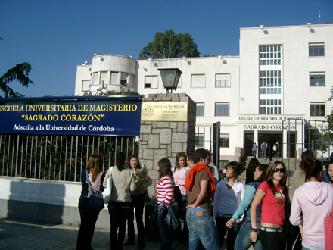
I study…
Degree in Primary Education

Slide 6
Why am I here?

Slide 7
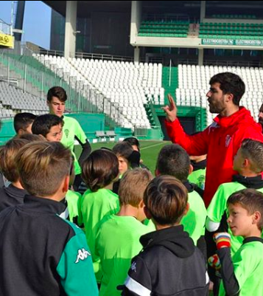
I work as a…
Football coach!

Slide 8
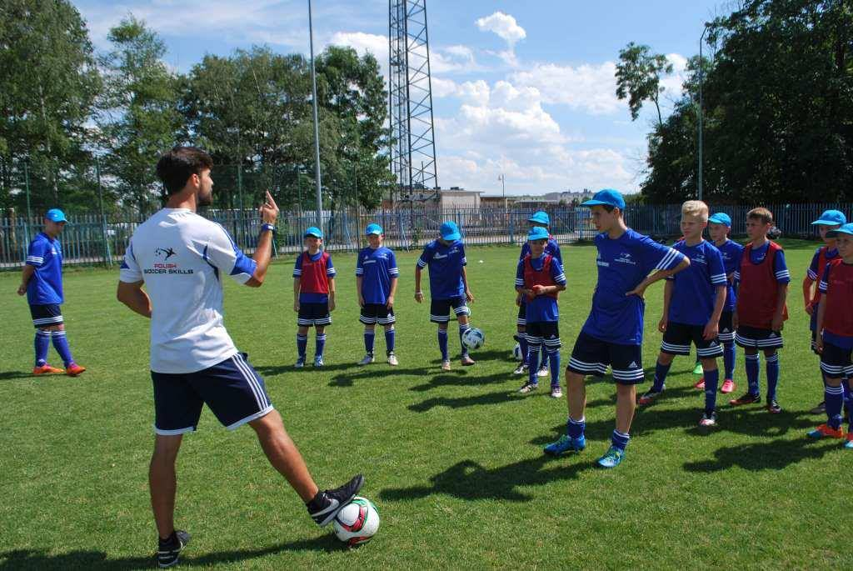
Polish Soccer Skills
Jarocin 2016
https://entrenandoporahi.wordpress.com/

Slide 9
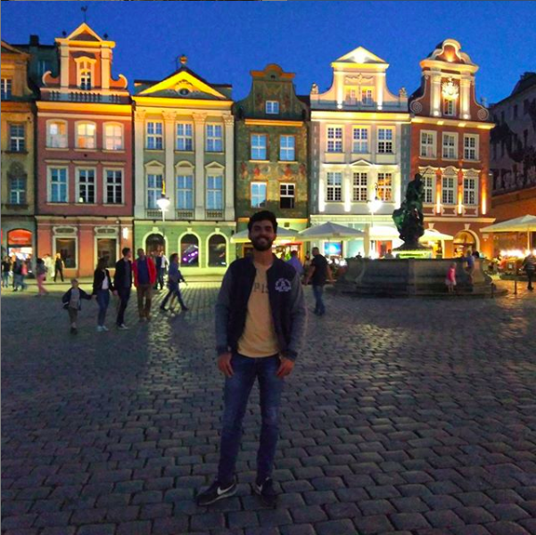
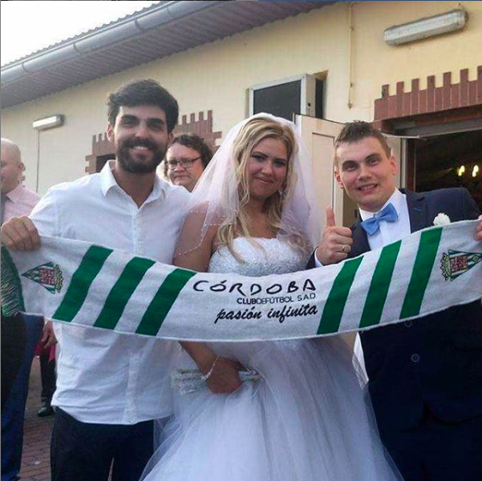
Great moments!
Poznan
Wedding in Kepno

Slide 10
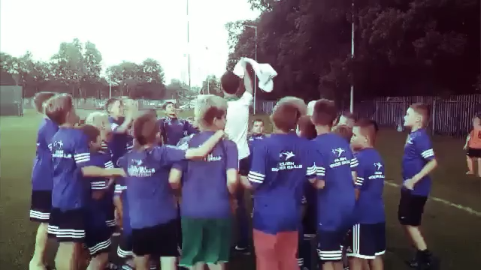
I had to come back!

